Slide 1
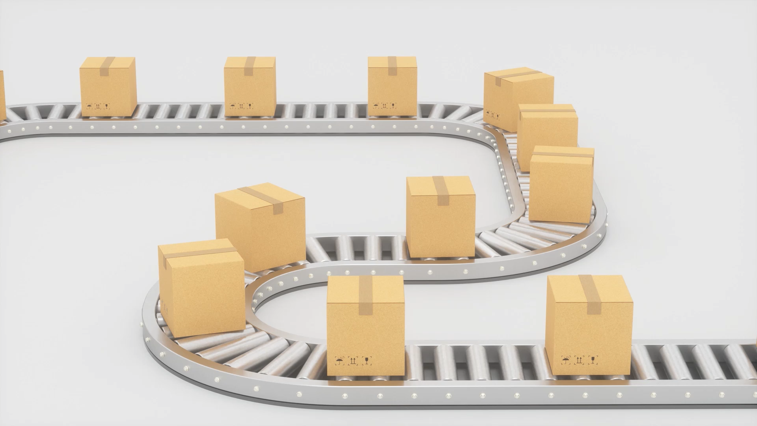
Enhancing Contrastive Learning using Optimal Transport
Improving Negative Sampling for Multi-modal Contrastive Learning
Aishwarya Kumaran, Akash Mittal, Stephen Owesney

Slide 2
Introduction to Contrastive Learning
Contrastive Learning:
Self-supervised learning technique
Aims to learn rich representations by..
Aligning similar (positive)
Distinguishing dissimilar (negative)
Common Applications:
Aligning multi-modal data (especially image-text pairs)
Models like CLIP and ALIGN have achieved significant success

Slide 3
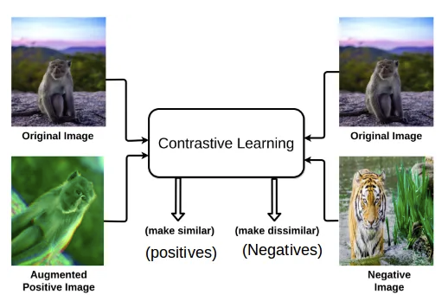

Slide 4
Why Enhance Contrastive Learning?
Key Challenges:
Generation of diverse negative samples is crucial but challenging
Current methods often lead to trivial / redundant negative examples
Problem with Negative Sampling:
Poorly sampled negatives result in suboptimal representations
Limits model generalization
Reduces effectiveness of learned features
Our Goal:
Improve the diversity and quality of negative samples using OT

Slide 5
Problem Statement
Objective:
To enhance the contrastive learning process by computing an entropy-regularized OT plan
Generate diverse and challenging negative examples while aligning modalities
Approach:
Utilize a combinatorial OT algorithm to dynamically adjust the OT plan
Evolving OT plan ensures stable alignment across batches
Helps the model learn better representations

Slide 6
Why Optimal Transport?
Optimal Transport
A framework for distribution alignment
Enables precise alignment of positive and negative pairs
Benefits of OT:
Generates diverse negative pairs, addressing redundancy
Prevents sudden shifts in the representation space
Drawbacks of OT:
EXPENSIVE!

Slide 7
Existing Contrastive Learning Approaches
CLIP and ALIGN:
Align image-text pairs by maximizing agreement between corresponding pairs
Minimize similarity between non-matching pairs
Limitations:
Negative sampling is often random or insufficiently diverse
Poor model generalization
Reduced feature discrimination

Slide 8
Negative Sampling in Existing Models
SimCLR:
Uses random sampling of negatives from current batches
Limitation: Can still lead to redundancy
MoCo:
Introduces a momentum encoder and dynamic queue to store negatives across batches
Provides more diverse negatives but relies on stability of queue
Our Approach:
OT Plan offers more structured and evolving negative sampling
Addresses MoCo’s limitations

Slide 9
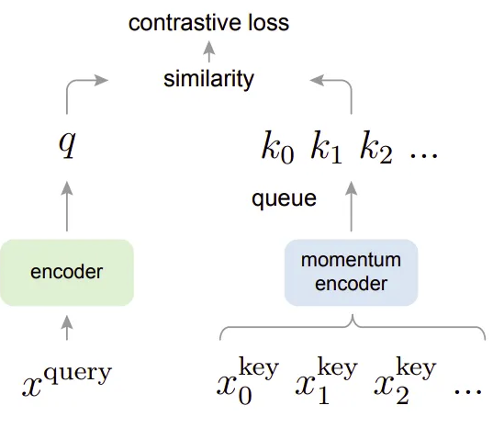
MoCo’s Architecture

Slide 10
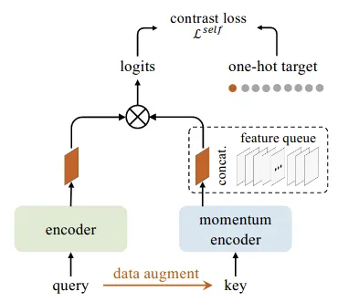
MoCo’s Architecture

Slide 11
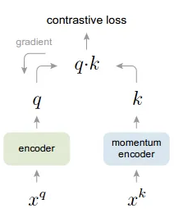
Momentum Encoder Architecture with a gradient on the encoder branch only

Slide 12

Our Methodology: Overview
We introduce a contrastive learning framework leveraging OT
Challenges in Existing Methods:
Overfitting on easy negatives
Limited diversity in negative samples
Our Solution:
Use OT to generate high-quality, diverse negative samples
Preserve representation diversity through caching OT plans
Regularize using Sinkhorn Divergence for stability

Slide 13

Feature Extraction: Image & Text Encoders
Input:
A batch of images:
A batch of corresponding text descriptions:
Encoding:
Visual Features: Extracted using ResNet
Textual Features: Extracted using BERT

Slide 14
Cross-Modal OT Plan Computation
Accumulate visual and text features over Δ batches
Compute the Optimal Transport (OT) plan:
Input: V (visual) and T (text) features.
Algorithm: Based on combinatorial approach to generate initial OT plan σ
Key Insight:
OT plan is cached
Allows for revisiting previous samples
Retains rich structural details across time

Slide 15
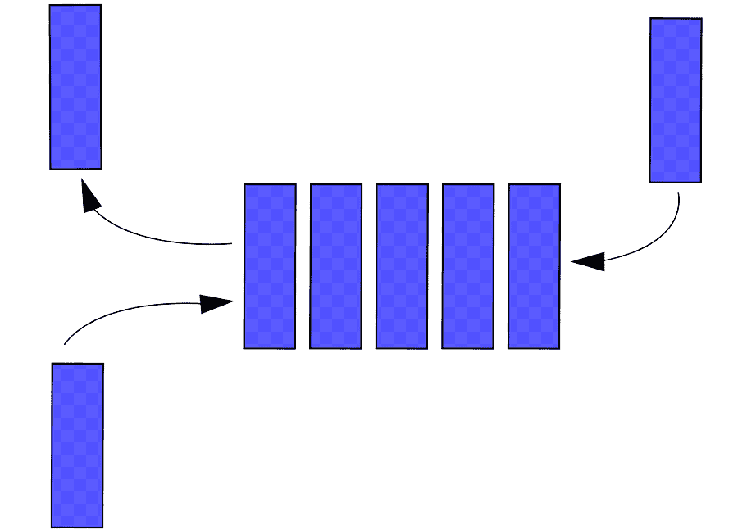
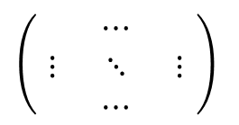
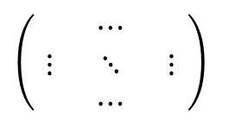
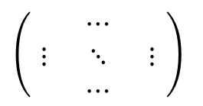
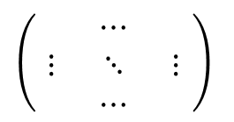
OTCO Architecture for Generating Negative Pairs
Texts
Images
$$\left(\begin{matrix} & ⋯ & \\ ⋮ & ⋱ & ⋮ \\ & ⋯ & \end{matrix}\right)$$
OT Plan
$$\left(\begin{matrix} & ⋯ & \\ ⋮ & ⋱ & ⋮ \\ & ⋯ & \end{matrix}\right)$$
$$\left(\begin{matrix} & ⋯ & \\ ⋮ & ⋱ & ⋮ \\ & ⋯ & \end{matrix}\right)$$
OT Plan
$$\left(\begin{matrix} & ⋯ & \\ ⋮ & ⋱ & ⋮ \\ & ⋯ & \end{matrix}\right)$$
Encoder
Encoder
Images
Texts
OT QUEUE
Notes:
For a batch of images representations and text representations we first compute a OT Plan
The OT Plan is used as a generator to convert images into texts and texts into images (OT is a mapping of distributions) and with a few samples our OT plan is not perfect
The OT plan is then stored in a queue therefore instead of have a dictionary of negative examples we have a potential dictionary of generator functions so we have a better supply of negative examples

Slide 16
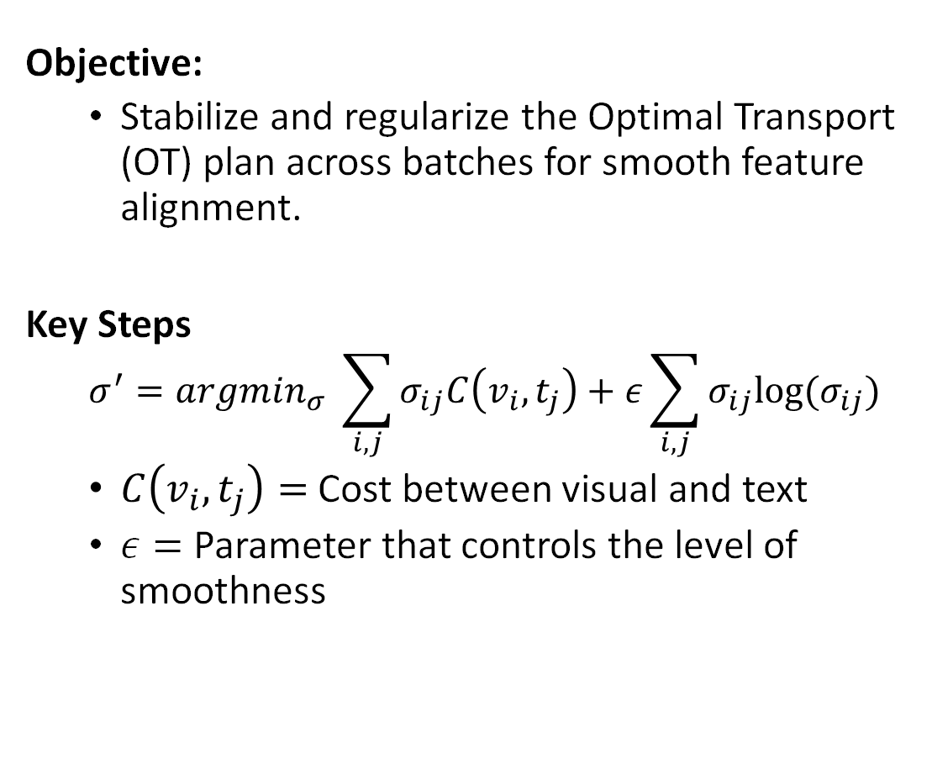
Sinkhorn Divergence for Entropy Regularization
Objective:
Stabilize and regularize the Optimal Transport (OT) plan across batches for smooth feature alignment.
Key Steps
$$σ^{′}=argmin_{σ} \sum_{i,j}{σ_{ij}C\left(v_{i}, t_{j}\right)+ε}\sum_{i,j}{σ_{ij}log(σ_{ij})}$$
$C\left(v_{i}, t_{j}\right)=$ Cost between visual and text
$ε=$ Parameter that controls the level of smoothness
Notes:
1)

Slide 17
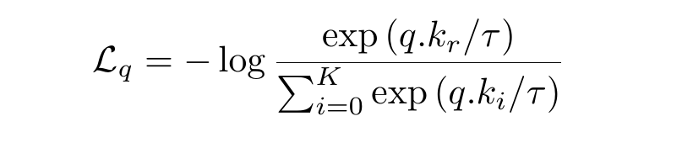
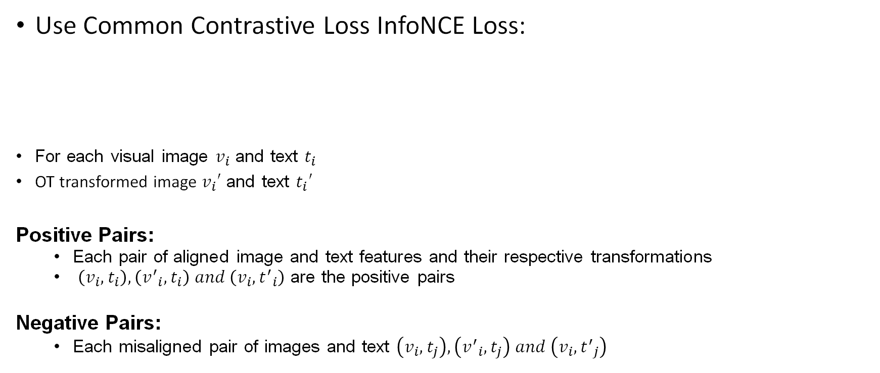
Contrastive Learning with InfoNCE Loss
Use Common Contrastive Loss InfoNCE Loss:
For each visual image $v_{i}$ and text $t_{i}$
OT transformed image $v_{i}′$ and text $t_{i}′$
Positive Pairs:
Each pair of aligned image and text features and their respective transformations
$\left(v_{i}, t_{i}\right), \left({v^{′}}_{i}, t_{i}\right) and \left(v_{i}, {t^{′}}_{i}\right)$ are the positive pairs
Negative Pairs:
Each misaligned pair of images and text $\left(v_{i}, t_{j}\right), \left({v^{′}}_{i}, t_{j}\right) and \left(v_{i}, {t^{′}}_{j}\right)$

Slide 18
Periodic Updates to the OT Plan
After processing each set of ∆ batches,
Rerun the combinatorial algorithm and apply Sinkhorn regularization to update the OT plan σ.
Store the OT Plan: Save the updated OT plan in a dictionary for future reference
Storing of OT plans allows us to have a dictionary of generator functions which allows us to “infinite” negative examples.
Notes:
As the model progresses we need to improve our quality of negative examples therefore we need to update the OT plan.
Therefore after a batch of text and image data we recalculate OT with sinkhorn regularization in order to get smooth plans.
We can like MOCO store negative examples by storing generator functions.

Slide 19
Results
We are still training OTCO…
Some Challenges we had:
During Thanksgiving break, we faced significant delays in convergence while processing a few batches of FLICKR 30K images and captions. We think it’s because of our OT solver.
We have changed our OT solver to an additive approximation OT solver a week back and running our experiments again.

Slide 20

Future Work
Results required to move forwards
Our original idea had a unimodal OT plan that would create a way to rollback between batches.
Further exploration of setup

Slide 21

Thank You

Slide 22

Questions

